Slide 1
Great Expectations and the End of the Depression
By Gauti B. Eggertsson
AER 2008
Notes:
Titile page

Slide 2
Liquidity Trap
Short-term nominal interest rate is 0.
Old Keynsian literature: monetary policy is ineffective in this case
Modern view: monetary policy is still effective. What matters are people’s expectations of future supply of money.

Slide 3
Overview
US recovery from the Great Depression was driven by a shift in expectations.
This shift was caused by President Roosevelt’s policy actions
Abolish the gold standard
Announce the explicit objective of inflating the price level to pre-depression levels
Expand real and deficit spending
All these actions violated prevailing policy dogmas, thus initiated a policy regime change.
The regime change is formally modeled a repeated game in a DSGE framework and evaluated quantitatively.
Notes:
1. Expanded spending made his announcement creditable.

Slide 4
Historical Background: Roosevelt was elected president in November 1932 and inaugurated in March 1933, succeeding President Hoover .

Slide 5
How bad the economy was at the turning point:
March of 1933:
Short term interest rate 0.05%
Output contracted by 13.4% in 1932
CPI dropped by 10.2 percent in 1932
Unemployment rate 24. 9%

Slide 6
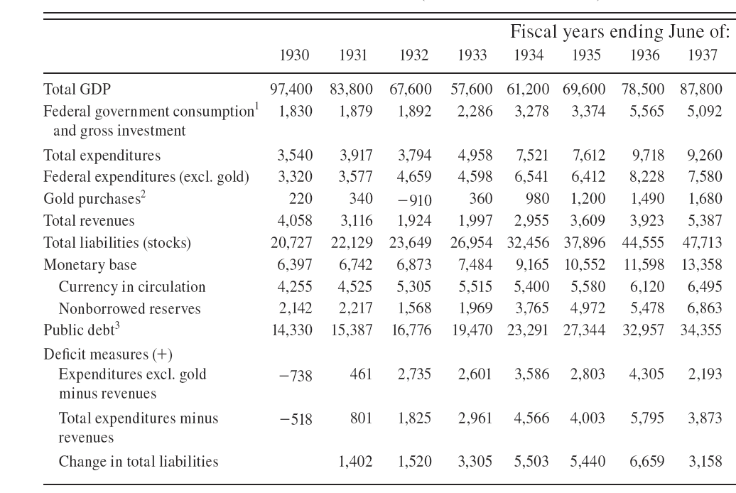
The Turning Point
Quoted in the Wall Street Journal:
“ We are agreed in that our primary need is to insure an increase in the general level of commodity prices.”
Dramatic increase in government spending
Dramatic increase in nominal liabilities
Notes:
First made public announcement of his determination….But he did more than simply announce his desire to raise prices. …he also took actions, actions that made his announcement credible.
------------How is the government spending financed? Not by new taxes, but by running budget deficits.

Slide 7
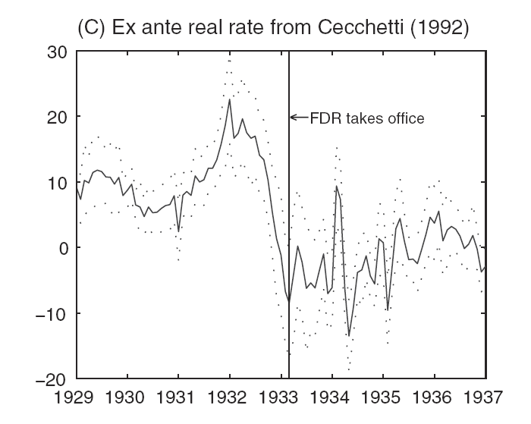
Regime Change:
Notes:
Price Level: persistent deflation was turned into modest inflation
Industrial Production: After fall for three consecutive years, a jump in monthly industrial production appeared right after the inaugaration.

Slide 8
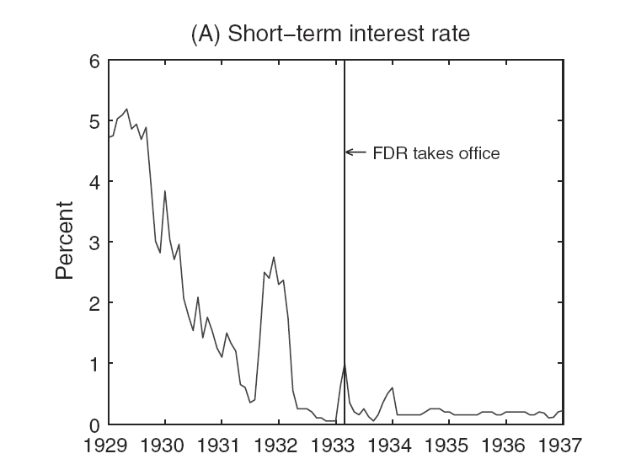
Regime Change: Continued
Notes:
Fact: neither the nominal interest rate nor the money supply changed much at the turning point.
What changed is the expectation about how they would be set in the future, leading to the change in inflation expectation.

Slide 9
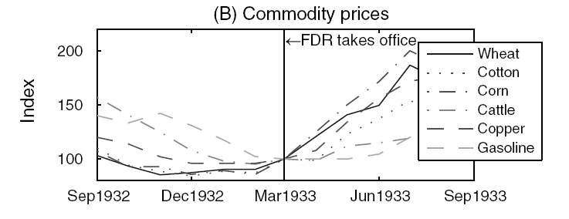
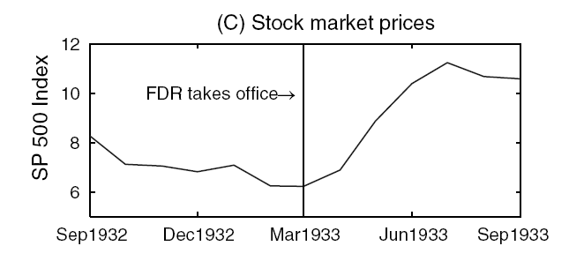
Shift in Expectation
Notes:
We have a year window of a monthly price index, commodity prices and stock market index, all of which are highly volatile and should respond strongly to a shift in expectation.

Slide 10
Relations with Existing Literature
Zero Bound literature
Focus on regime change
Great Depression in DSGE models with shift in expectations
Explicitly model why and how expectations are changed in 1933 with Roosevelt’s inauguration

Slide 11
Model: Private Sectors
A representative household maximizes:
with
A representative firm:
Technology is linear in labor
Maximizes expected discounted profits
Face a cost of price changes , where .
Notes:
Greek letter Pi

Slide 12
IS and AS
IS:
where
AS:
where
Notes:
We have two Euler equations: one for the household, one for the firm

Slide 13
Government and Equilibrium
Total government spend:
Government budget constraint:
with .
Excluding Ponzi Scheme:
Market Clearing:
Assumption of habit formation:
Zero bound on the short-term nominal interest rate:
Government takes the expectation functions as given:

Slide 14
Without imposing policy dogmas, the government’s maximization problem is:
such that all the constraints on the previous page are satisfied.

Slide 15
The Hoover Regime: Policy Dogmas must hold The Roosevelt Regime: Policy Dogmas were dropped What are the Policy Dogmas?
“Small Government” dogma
“Blanced Budget” dogma
“Gold Standard” dogma
Notes:
First dogma captures Hoover’s view that the government should be kept small at its current level.
Second dogma: the government should never spend beyond its means

Slide 16
Exogenous Shocks
Key Features in the data in 1929-1933:
a. short-term nominal interest rate close to 0
b. output dropped
c. prices declined
Can common shocks in the business cycle literature generate such features?
Productivity shocks
Markup shocks
Money demand shocks
No!
Notes:
We are almost there, except One thing: we have not specify the exogenous shocks to the model.

Slide 17
Intertemporal Shocks
Intertemporal shocks: exogenous shocks that imply a lower real interest rate is required for demand to remain unchanged. ( banking problem, stock market crash).
Formally,
Notes:
In order to characterize the intertemporal shocks, we need to know: value of rel, and the distribution of tau.

Slide 18
Why a Negative Real Interest Rate is Needed?
Real interest
rate
Slackness
Savings
Investment

Slide 19
Purely intertemporal shock: The efficient level of output and government spending remains constant. The following two conditions are needed for equilibrium:
Notes:
In an efficient world without frictions like nominal rigidity and policy dogmas, the shock would not course output to drop. Thus if there is any drop in output after the shock hits the economy, it’s due to the propogation mechanism in the model. ---------Now we have enough equations to close a linear approximation of the model. ------

Slide 20
Solving the model
The model is solved in two steps:
1). Solve it for periods when the real rate has reverted to steady state.
2). Calculate expectations before the stopping time, taking the solution in part 1) as given.

Slide 21
Characterizing the Hoover Regime: (Notation: , )
Notes:
In Monetary policy, the Fed behaves as if it follows a strict zero-inflation target, but with the twist that if may not be able to achieve it if the efficient real rate is negative. As a consequence, if the prices falls due to the shock, the fall will not be undone by subsequent inflation.

Slide 22
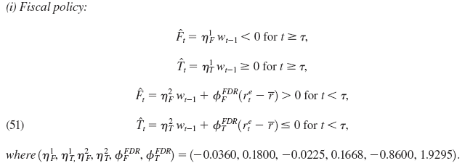
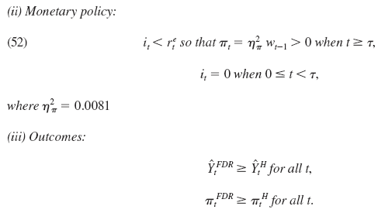
Characterizing the Roosevelt Regime
Notes:
Fiscal policy is countercyclical. The government respond to contraction by increase in both real and deficit spending. ( consistant with R’s policy)
Interest rate will remain low even after…..different from Hoover regime ( commitment to keep the interest rate low for much longer time)

Slide 23
Further Comparison:
Hoover Regime | , | ,
Roosevelt Regime | ,

Slide 24
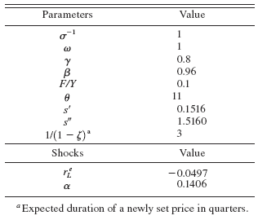
A Calibrated Example: Calibration
Notes:
Theta 11 means 10 percent markup. Alpha means average duration 7.1 years. Average duration of price adjustment to be 3 quarters.

Slide 25
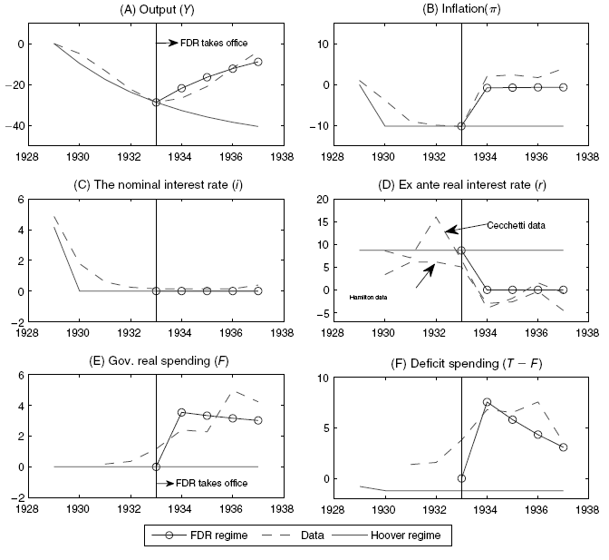
Notes:
The figure is plotted under the assumption that real rate is in low state for the 1929 to 1937. Hoover replicates data relatively well for 1929 to 1933. Roo…. Vertical line is when one leaves offiche, the other… Output: 40% decrease in steady state ; now regime change results in an increase in both output and inflation -----The policy instruments that drive the expansion are the aggresvied ……

Slide 26
An interesting question to ask:
Could it be that the real rate reverts back to steady state at 1933, thus the turning point and Roosevelt’s inauguration coincided?
No!

Slide 27
How expectation plays the critical role? The Hoover regime:
(1):
(2):
Quasi-growth rate depends on both current and expected future real interest rate.
Zero inflation targeting and zero interest rate bound.
High real rate leads to output contraction
By (2) leads to deflation
Shocks are persistent, thus people expect output contraction and deflation to occur in the future, thereby increasing expected future real rate, leading to further contraction

Slide 28
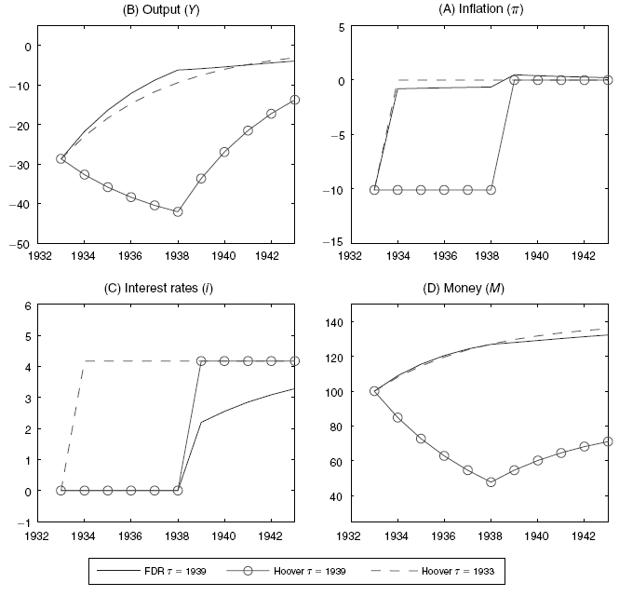
Starting from 1933, the shock reverts back in 1939:
Notes:
Hoover: government increases interest and achieves zero inflation as soon as the deflationary pressure goes away; leads to a vicious deflationary dynamics as explained in the previous slides
Roo: government keeps interest rate low for a longer time and accomodates some positive inflation. ..Better Output:…..implies much higher money supply

Slide 29
Why Roosevelt regime increases output?
The commitment to reflate the price level
The commitment to future low interest rates
The commitment to higher future output
The increase in government spending
Notes:
Opposed to vicious circle, this is kind of virtuous circle. ------The commitment to reflate the price level implies lower real interest rates, which stimulates spending, even if nominal interest rate is zero. ----------The commitment to higher future output stimulates spending through permanent income hypothesis.---The commitment to higher future output stimulates spending through permanent income hypothesis.

Slide 30
The Gold Standard Dogma
In the 1920s, US government needs to keep gold reserve corresponds to 40% of its monetary base, the price of gold is $20.67 per ounce.
Support the conventional wisdom: going off the gold standard was crucial for the recovery.
Notes:
Hoover regime, no need to worry about it: Roo regime: need to drop it to make policy credidble.

Slide 31
Conclusions:
What separates the regime of Hoover and Roosevelt: elimination of several policy dogmas.
This elimination accounts for about 70 to 80 percent of recovery of output and prices in 1933 to 1937.
In the absence of the regime change, would have continued the free fall, output would have been 30 percent lower in 1937 then in 1933 (in data: 39 percent increase).

Slide 32
Thank You!

